Slide 1

Blockchain & Cryptocurrencies Hackathon Week Launch Event
Dr. Muntadher Sallal

Slide 2
Agenda
- Hackathon Welcome
Hackathon introduction
Groups formation & Lunch break
Groups registration & Questions

Slide 3
Welcome & Introduction
Blockchain & Cryptocurrencies Hackathon 📍 Launch Event | Share Lecture Theatre | Fusion Building 🗓 02 June | 12:00 – 14:00

Slide 4
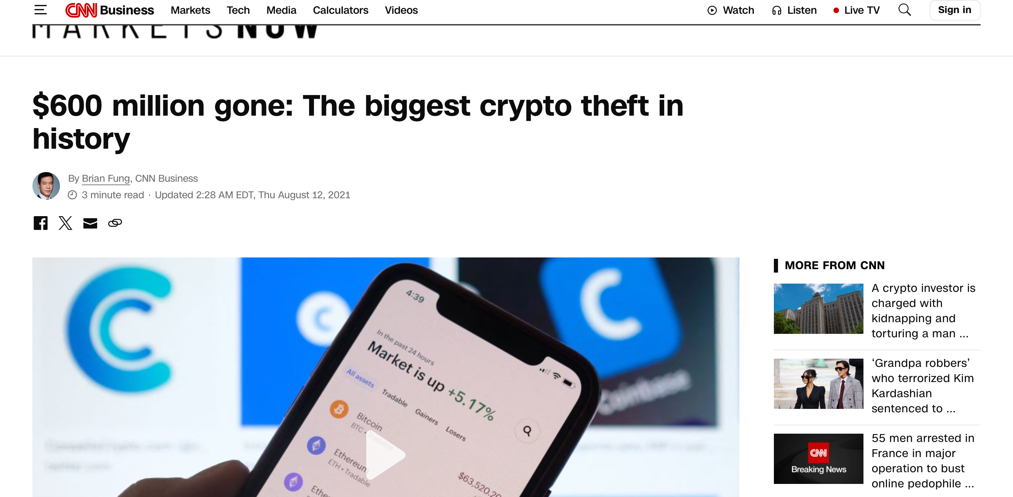
What if one line of code could cost $600 million?
In August 2021, the Poly Network hack exploited a smart contract flaw and drained over $600 million.
This wasn’t a failure of the blockchain, it was a failure of code security.

Slide 5
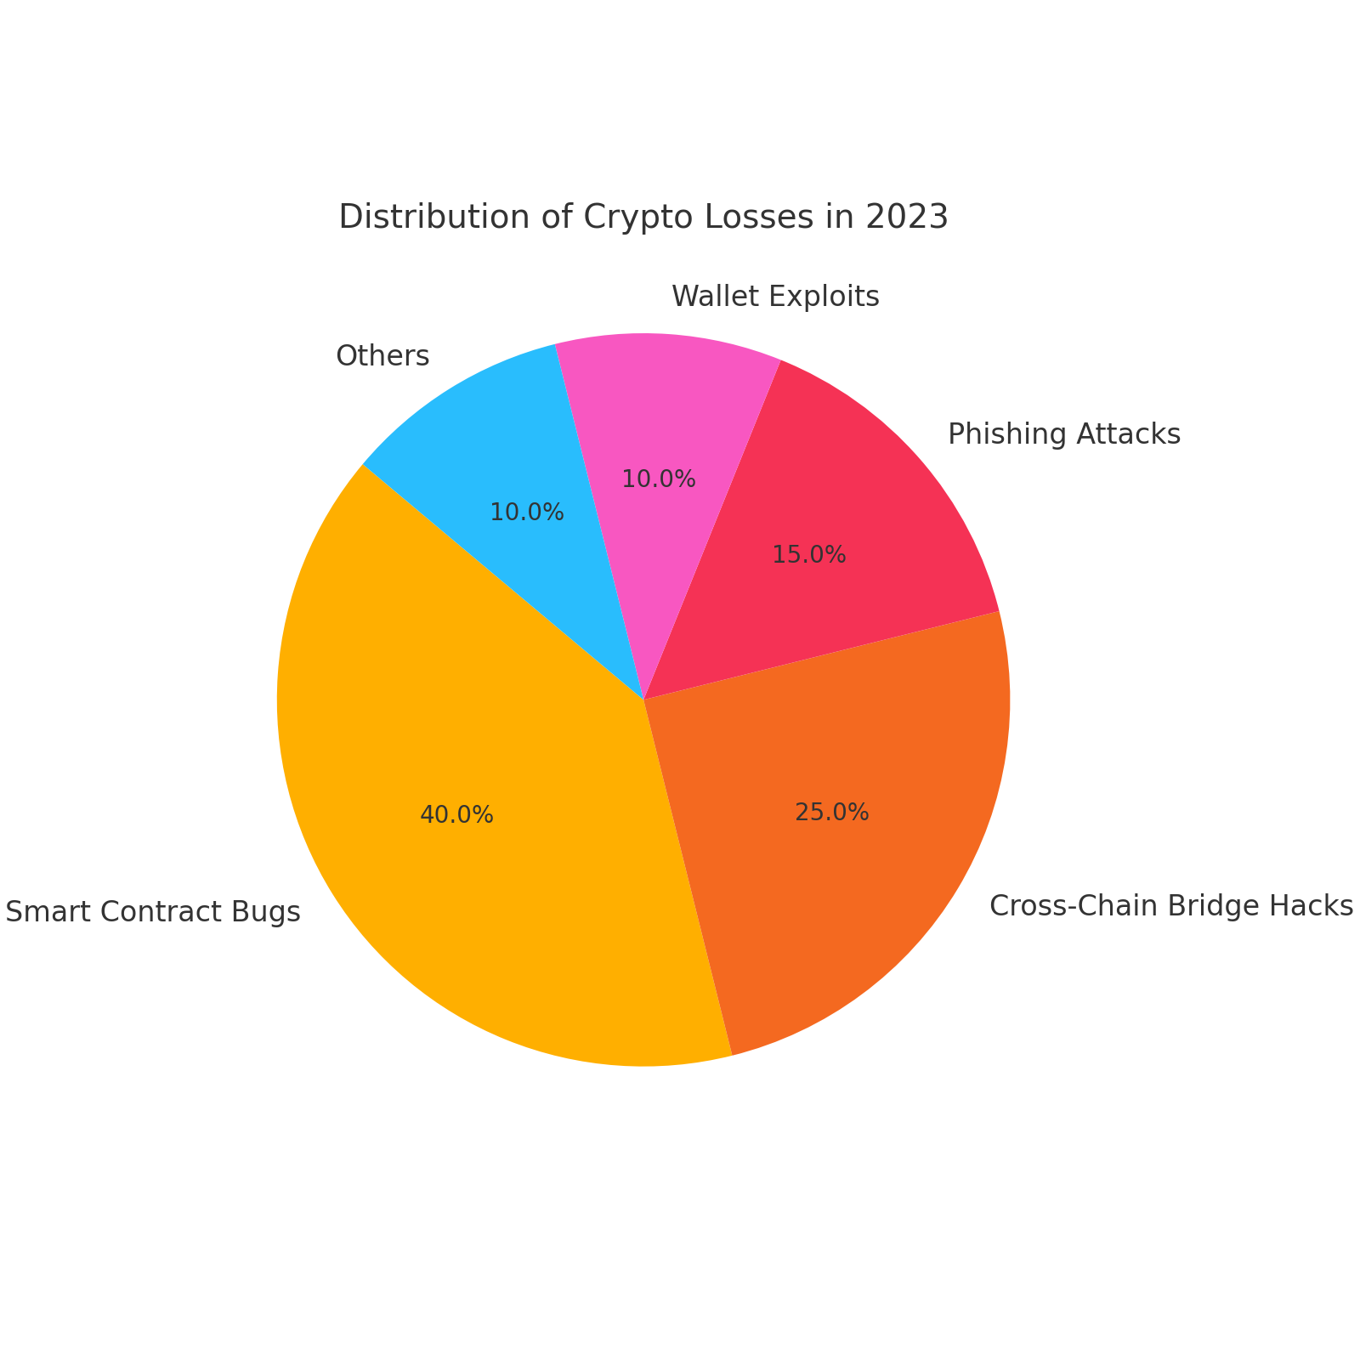
In 2022 alone, $2 billion was lost due to smart contract bugs
DeFi is booming — but with rapid innovation comes risk.
The main cause of blockchain exploits? Poorly secured smart contracts.
For example, Saddle Finance experienced a severe hack in April 2022 due to vulnerabilities in its smart contracts, resulting in the loss of millions of dollars.

Slide 6
Event Purpose and Goals
Blockchain and Crypto security audit
Purpose
Foster Collaborations
Goals
Security Awareness
Innovation and skills

Slide 7

Why Blockchain & Crypto Security is Crucial?
Blockchain is secure by design, but not invincible.
Cryptocurrencies and blockchain are emerging technologies driving the next generation of software development for Fintech
FinTech needs to adopt proper DevSecOps techniques to ensure security and trust

Slide 8
Why Blockchain & Cryptocurrencies?
Smart contracts, wallets, and DeFi apps are common targets of exploits.
- Applications development based on these technologies like NETS, dApps, promote serios security risks such as data privacy and integrity breach, fraud, and financial loss.

Slide 9
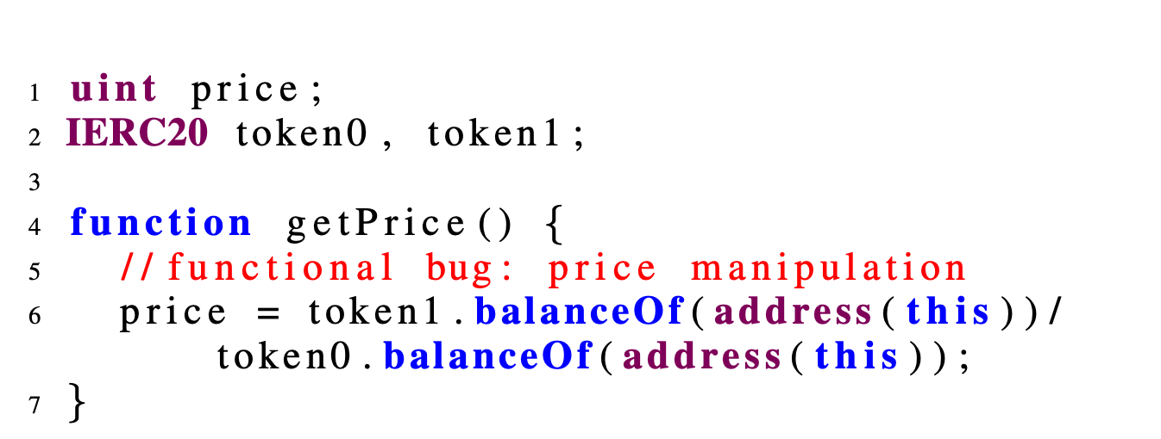
Possible Vulnerabilities? [Example 1]
Smart Contract Bugs

Slide 10
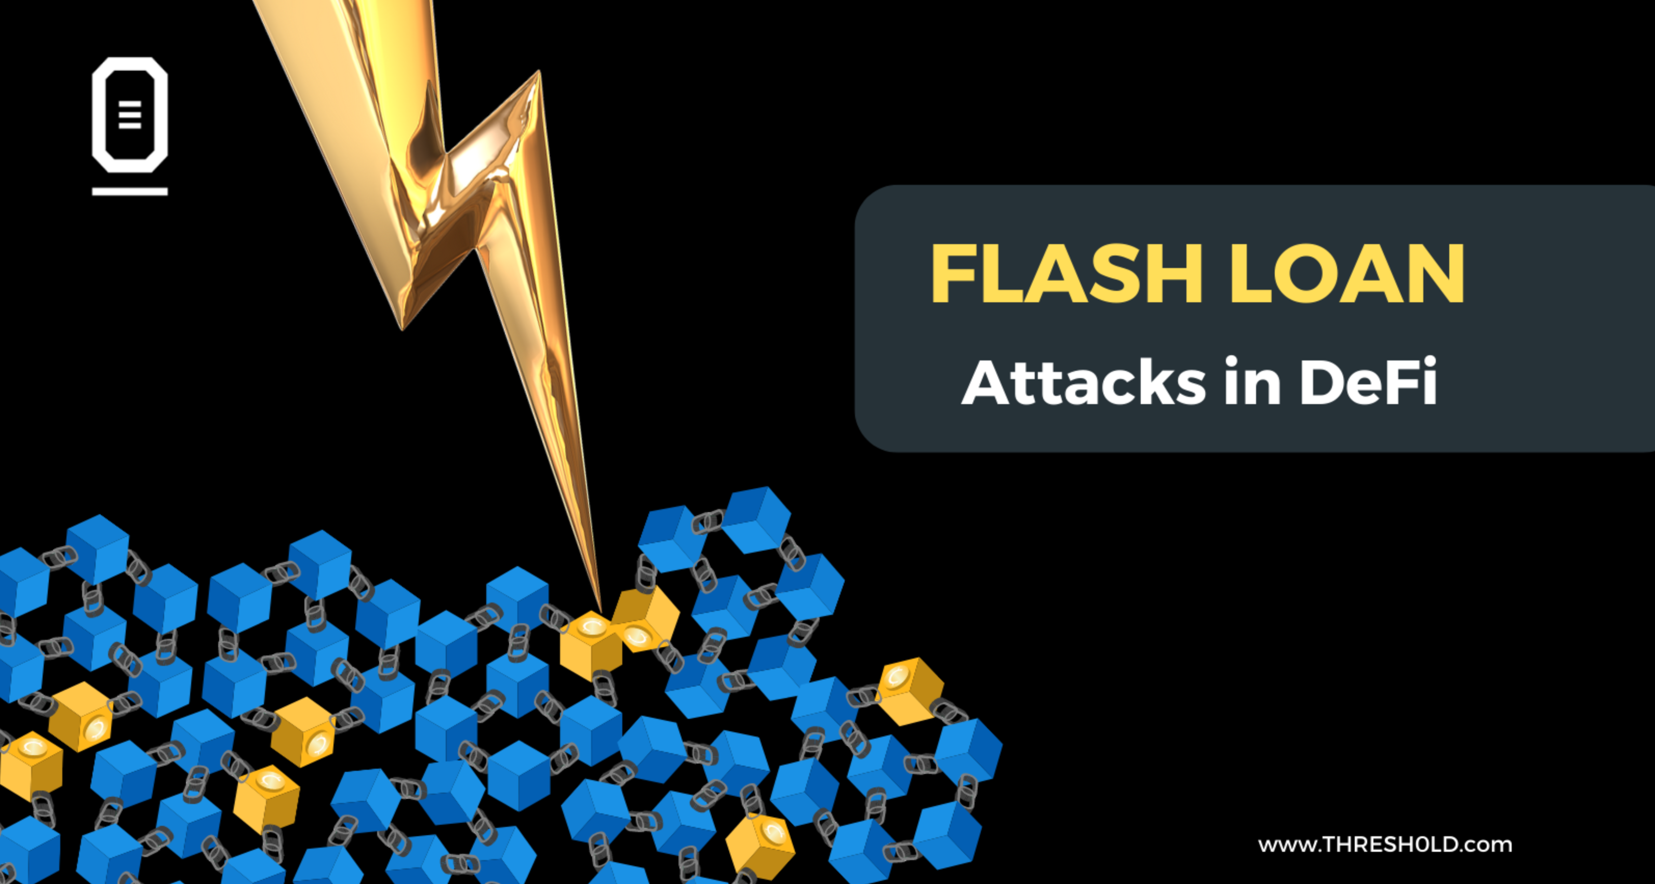
Possible Vulnerabilities? [Example 2]
Other breaches
Flash Loan
Oracle Manipulation
Anomaly behaviour

Slide 11
Action Required
We need security audit tools to check and verify DApp and DeFi applications vulnerabilities, including:
Smart contract
Blockchain network (nodes and Transactions)
Wallets

Slide 12
The Challenge

Slide 13
The Challenge
Participants are tasked with designing innovative security audit/assurance solutions tailored for the decentralised world.
Your mission: building tools, that can detect, and report vulnerabilities across the blockchain stack, with a sharp focus on DApps and cryptocurrency environments.

Slide 14
Audit Areas
Audit areas may include (but are not limited to):
Smart Contract Analysis: Static and dynamic analysis of Solidity and other smart contract languages to catch bugs, vulnerabilities (like re-entrancy, integer overflows), and inefficiencies.
Real-Time Network Monitoring: Track blockchain network activity to detect anomalies, suspicious patterns, or attacks.
Wallet Security & Transaction Validation: Tools that detect phishing and validate transaction intent before signing.

Slide 15
Ideas/ Examples
Possible ideas (but are not limited to):
1- Application can check the smart contract security vulnerabilities
2- Application that track blockchain network behaviour throughout behaviour and trust.
3- Application that strengthen wallet authentication where unauthorised attempts can be detected.
4- Application implement trust mechanism which checks blockchain network nodes behaviour
And so much more…

Slide 16
Tools and resources
1. Smart Contract Analysis:
Slither (Static Analysis) Best for: detecting vulnerabilities like reentrancy, uninitialised storage, shadowing, etc.
Mythril (Symbolic Execution) Detects: overflows, underflows, access control issues.
Foundry Includes: fuzzing, unit testing, and coverage reporting for Solidity.
LLM models
Includes: SmartInv, ContractWard, AuditGPT
Learning:
Ethernaut (by OpenZeppelin): Gamified learning for smart contract vulnerabilities.
Solidity official docs: https://docs.soliditylang.org/

Slide 17
Tools and resources
2. Real-Time Network Monitoring:
Tenderly Realtime monitoring and debugging for smart contracts on live chains.
Forta Decentralized threat detection network for Web3.
Ether.js or Web3.js Use to build custom monitoring bots or listeners.

Slide 18
Tools and resources
3. Wallet Security & Transaction Validation :
Web3Antivirus Chrome extension to detect phishing and malicious DApps.
Ethers.js Signer Can be used to simulate & verify user intent before transaction signing.
Rabby Wallet Open-source wallet that simulates transactions before signing.

Slide 19
Judging Criteria
Creativity
Technical Difficulty
Overall Execution
Presentation

Slide 20
Hackathon Week Schedule
Wednesday:
12:00 – 14:00
Drop-in session 12:00-14:00, Fusion Building, Room F305
Friday
Friday:
11:00 – 16:00
Showcase ceremony 11:00-16:00, Fusion Building, Share Lecture Theatre,
Wednesday

Slide 21

Prizes
1st place 200 amazon voucher
2nd place 150 amazon voucher
3rd place 100 amazon voucher
4th place 75 amazon voucher

Slide 22
Questions?

Slide 23

Lunch break
Please make sure to form your team:
1- Name your team
2- Each team should have up to 4 members
3- Please register your team here: https://forms.office.com/e/MMPmsmUxCF

Slide 24
Workshop
Date: Tuesday 03-06-2025 Time: 11:00 - 13:00 Room booked: F305

Slide 25
Workshop
Join Hackathon channel on Slack: https://blockchainand-viq5952.slack.com/archives/C08UY4WRC90
Blockchain and Crypto Hackathon | General | Microsoft Teams

